Slide 1

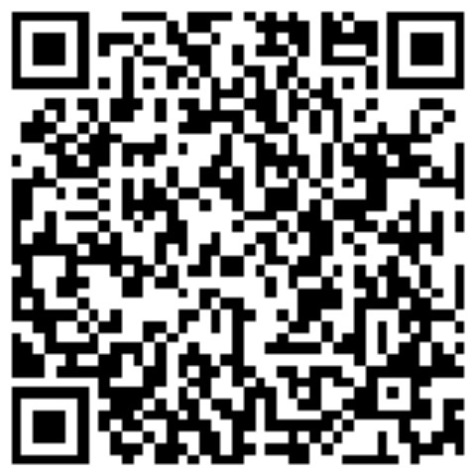

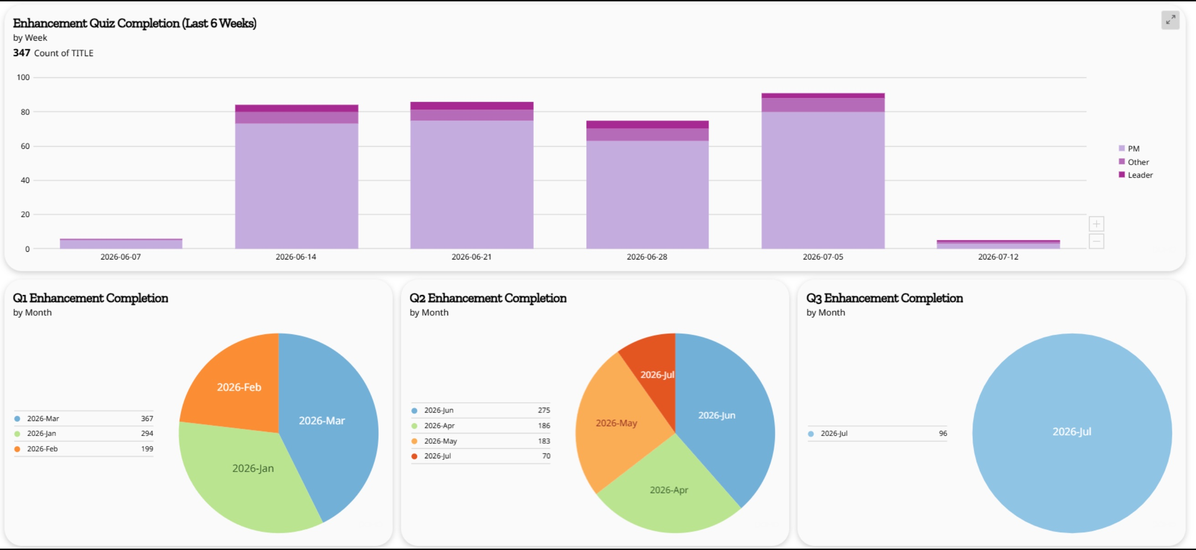

Business Strategy/Analytics Intern – Cox Automotive
Author: Amanda Giddings
Highlights
Since I was in the Business Operations side of Cox Auto, I:
Learned how to effectively clean and apply data
Applied clean data to a dashboard that was effective in assisting the Knowledge Management Director
Dashboard is designed to be used by other Directors/Managers and Assistant Vice Presidents (AVPs)
Assisted in the development of automated communication created from the dashboard
Assisted in the development of training documents for 300+ employees
Occasionally led trainings for 300+ employees in the absence of the Knowledge Management Director
Received my Lean Six Sigma Yellow Belt Certification
Utilized my new certification to plan and aid in the design of an additional automation project for the analyst team
Experience
For this internship, since I was in the Business Operations side of Cox Auto, I was able to truly experience and understand what business operations people are looking for from their data scientists. The job of the data scientist is to help them make informed decisions.
The dashboard I was tasked with fixing was meant to monitor the employees that attended the trainings that we hosted weekly. This dashboard provided the Directors and AVPs with percentages of their teams that were in attendance for these calls as well as the percentage of employees that completed their training. This also looked at the numbers for each fiscal quarter. Specifically, if anyone was not performing correctly or if we found that one of the trainees was losing clients, we could see if they were utilizing their trainings effectively. This dashboard is also intended to be used to justify the trainings since it does show the weekly attendees therefore showing there is a demand for this training.
Future Career Plans
I am in the process of graduating for the Fall 2026 semester. Following graduation, I would like to pursue analysts positions including positions in Business Intelligence Analysis now that I understand the position more. If Cox offered me a position, I would remain at their company as I enjoyed the culture and teams that I had the opportunity to work with.
Example of the dashboard:
Internship Description
As a Business Strategy/Analytics Intern, I assisted the Knowledge Management Director in the creation of a dashboard for her weekly training meetings and in the creation of the training materials for Courtney’s weekly calls. I was able to experience the difference in corporations and higher education institutions function as they serve their different client bases.
Conclusions
I had the opportunity to see the business side of analytics this summer while working with my team within Cox Automotive. I learned about the products that were being sold, how training was facilitated for those individuals, and whether the data showed that training supported the individuals in reaching their KPI standards.
Acknowledgments
Introduction
I am pursuing my Masters in Data Science an Analytics. I have a background working in higher education and my Bachelors in International Affairs. This was essential for the role that I went into this summer, because I had to assist in the training of over 300 employees weekly and development of dashboard items for upper leadership.
Shane Bennett – Business Intelligence Analyst
Courtney Cole – Knowledge Management Director
Jackie Matassa – Project/Product Management Director
Devante Norris – Business Intelligence Analyst
Bethany Johnson – Strategic Planning Director
Kate Mahone – Lead Project/Program Manager
Contact Information

